Slide 1

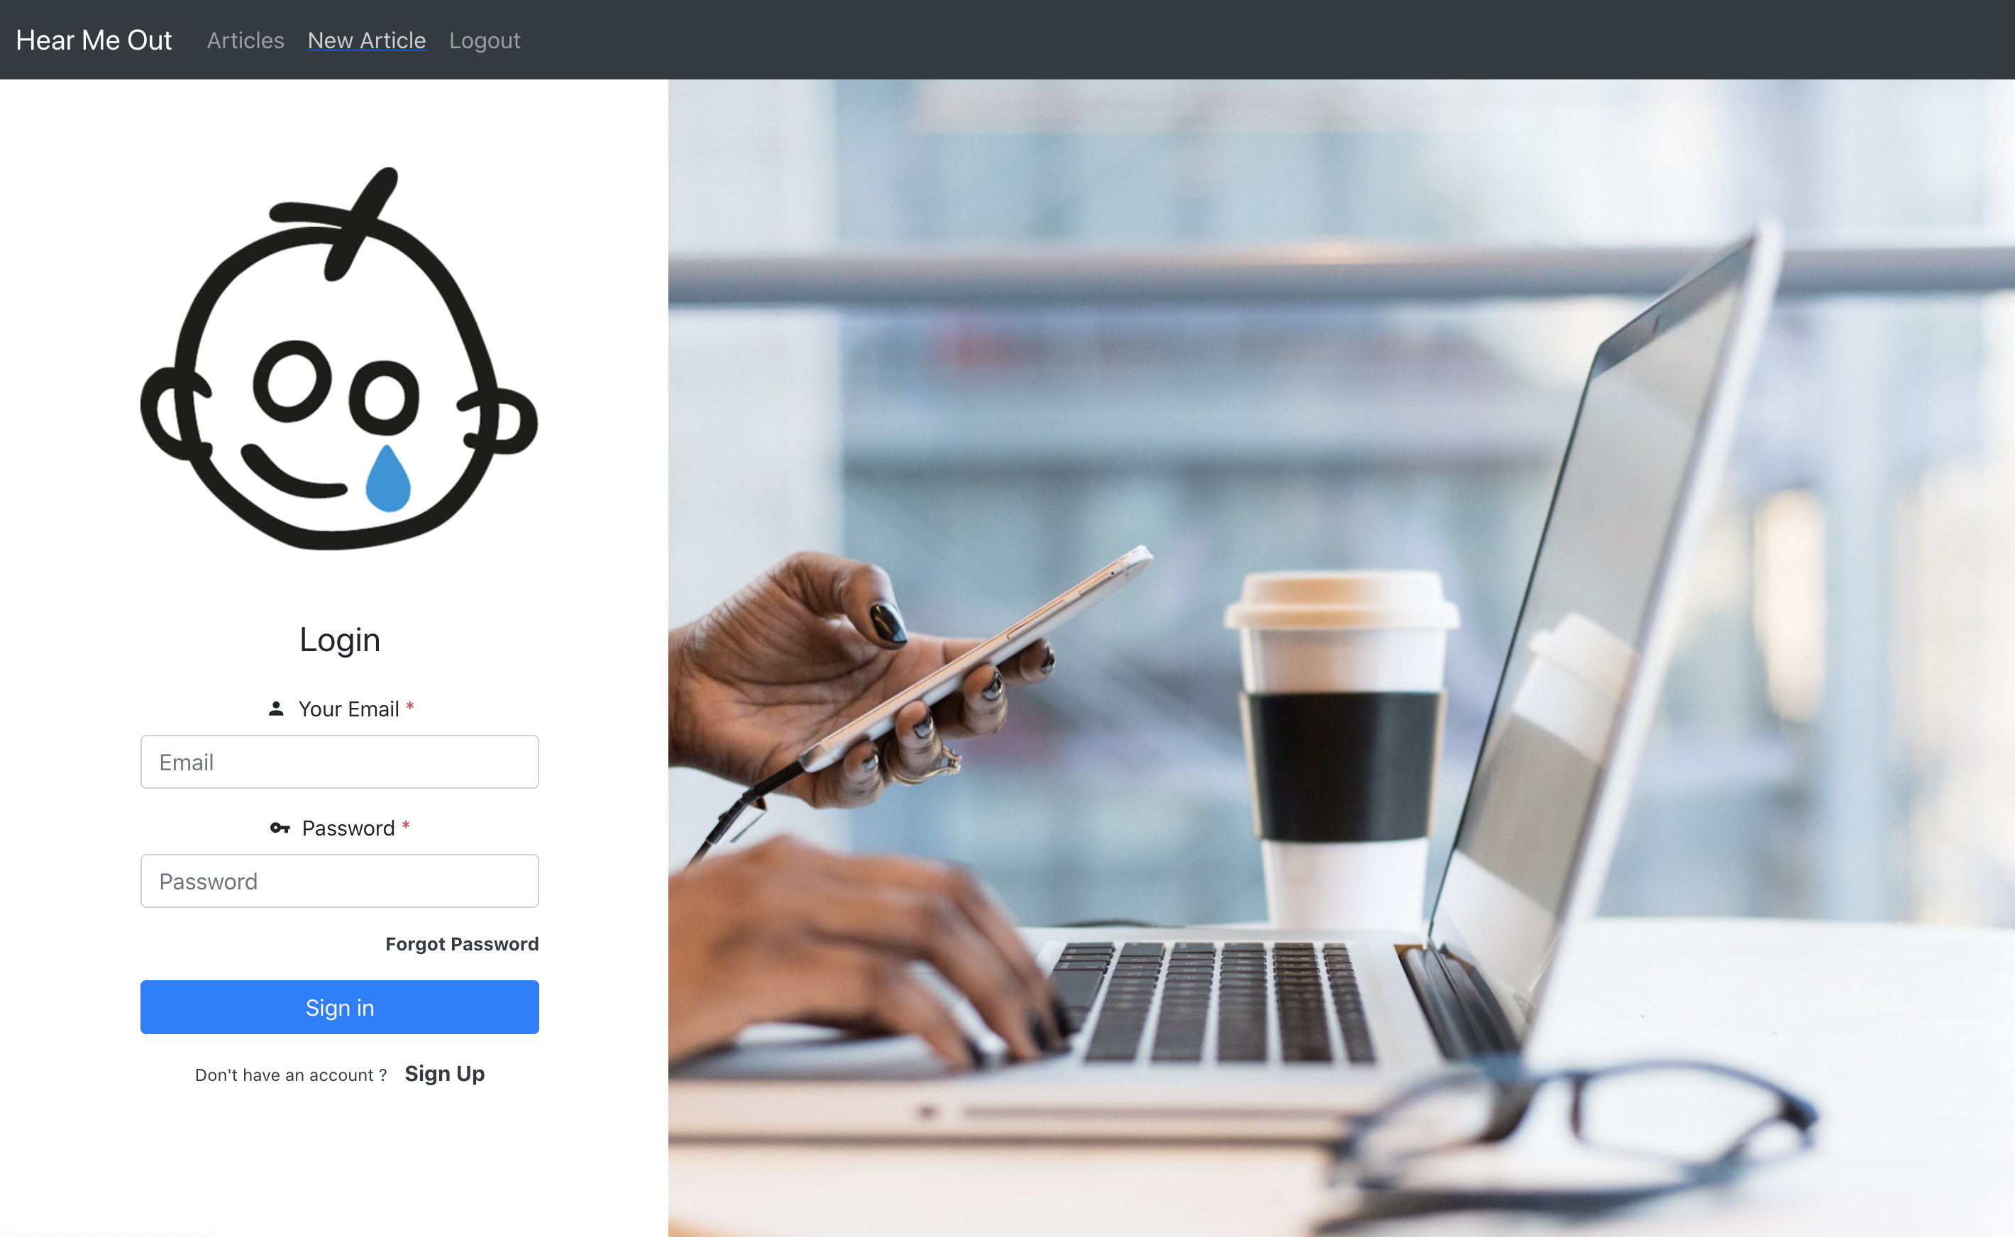
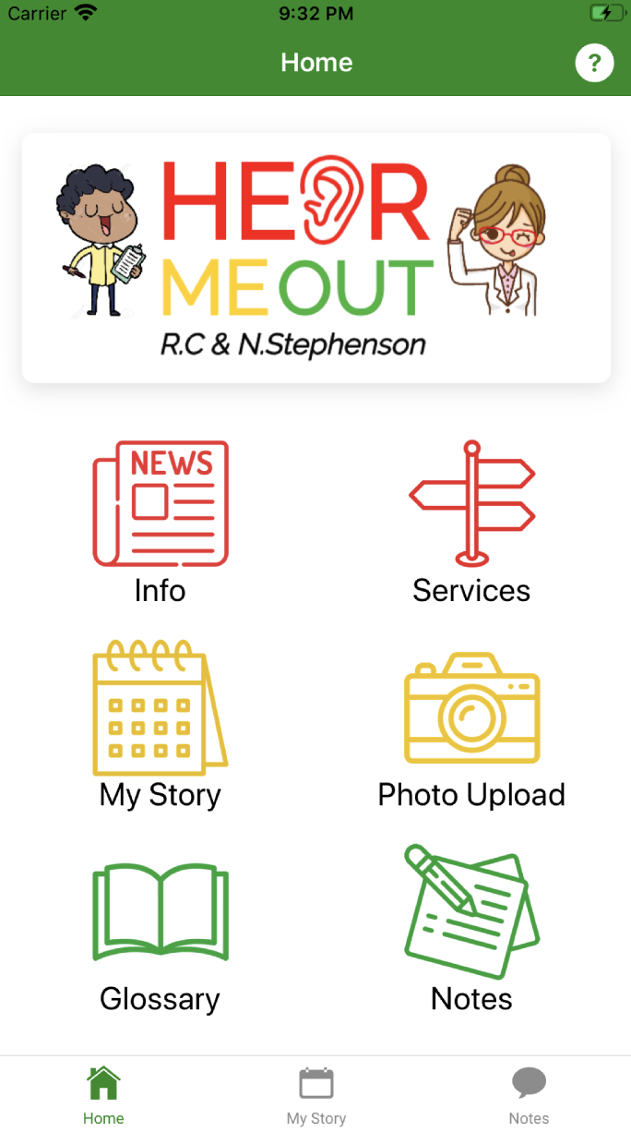
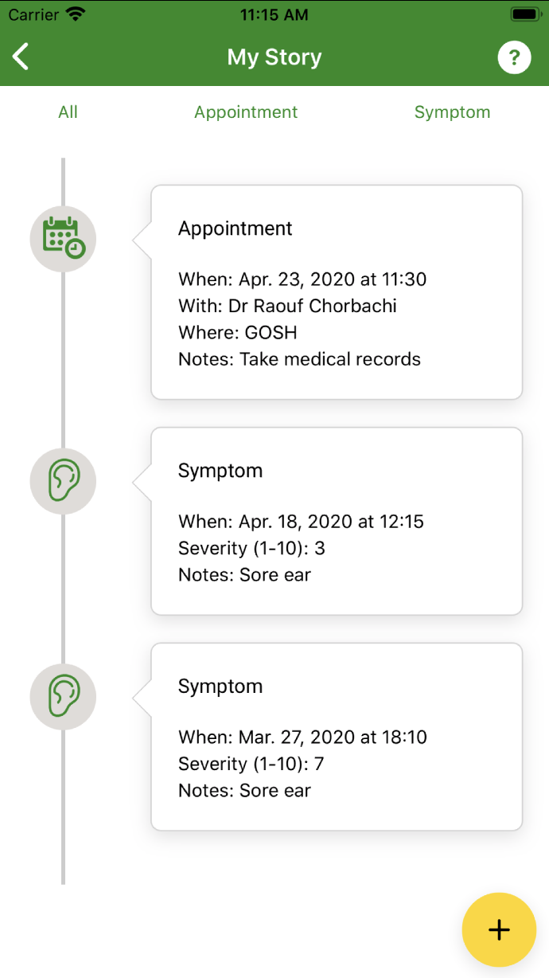
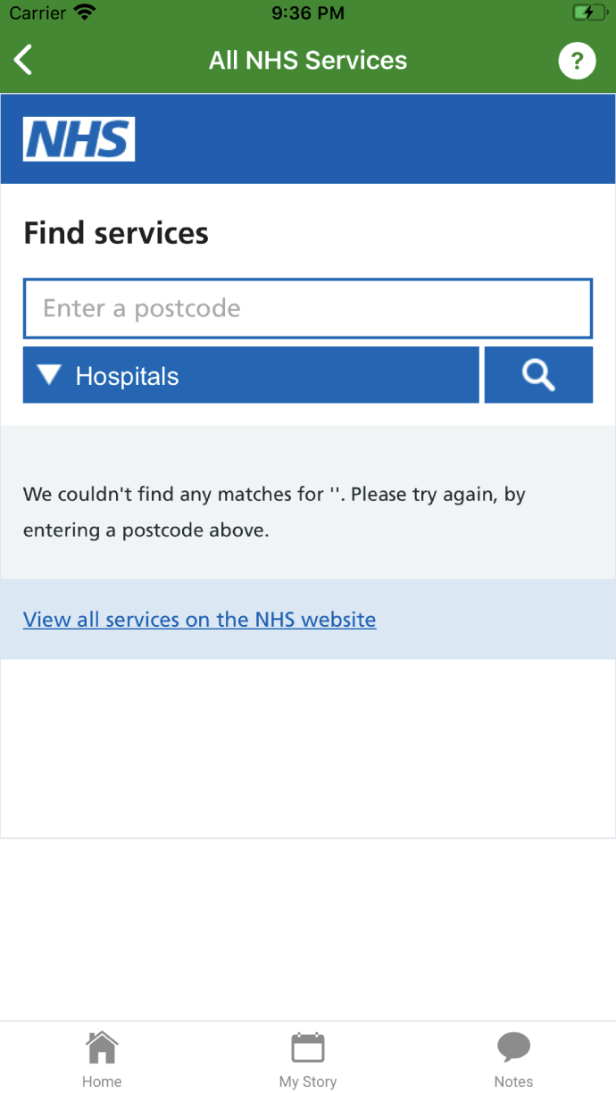
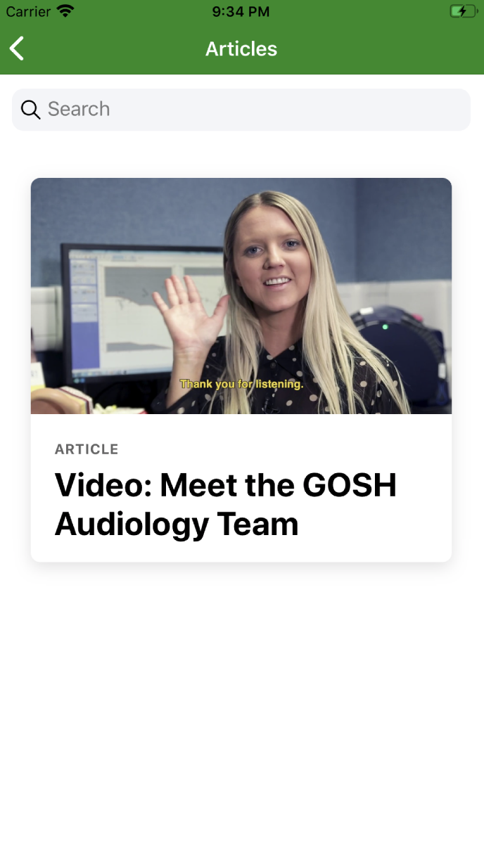
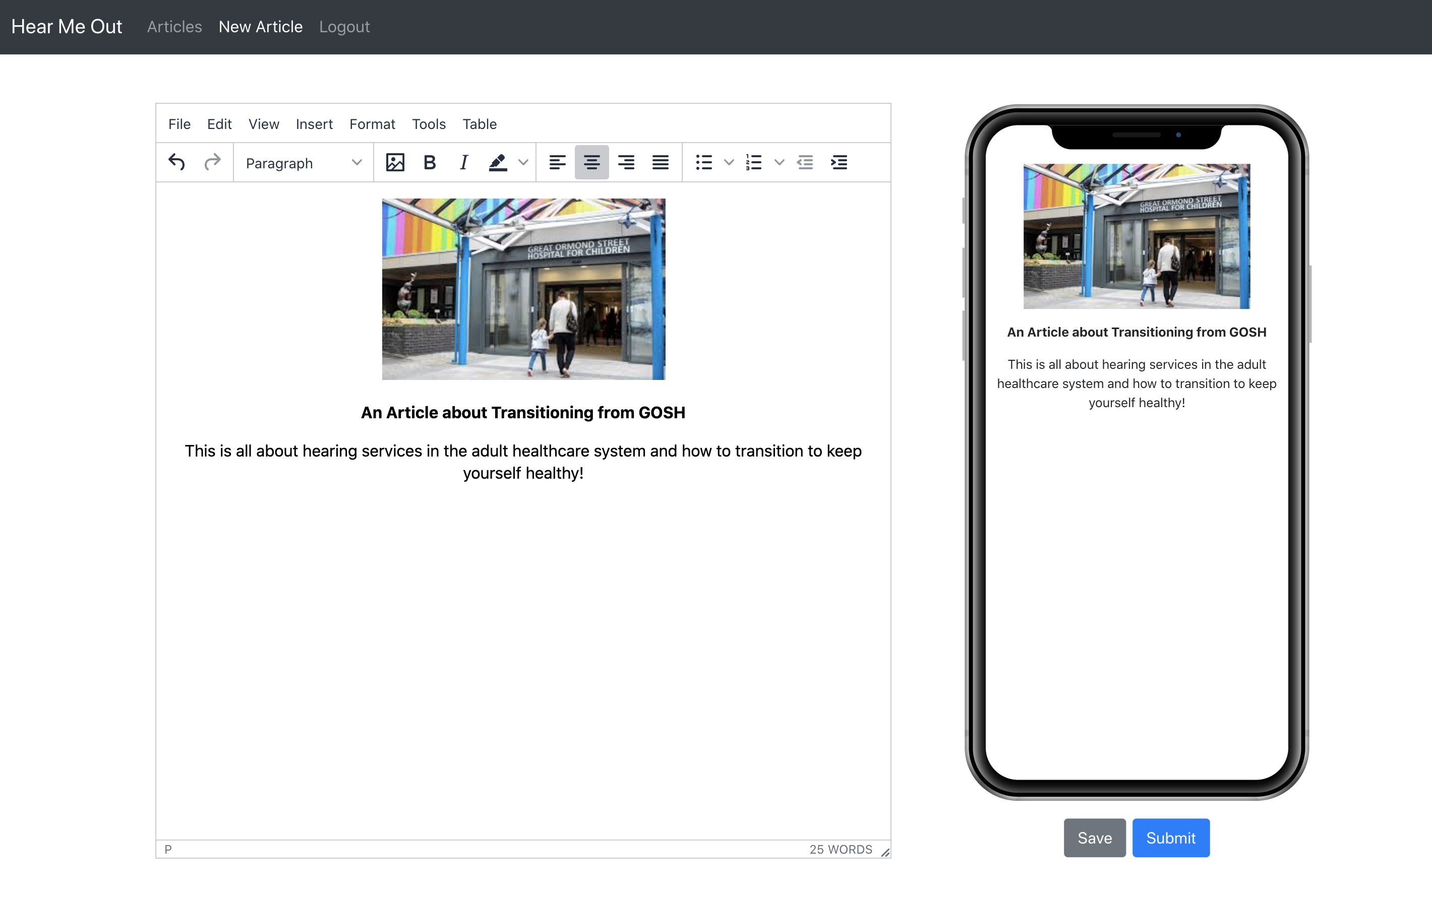
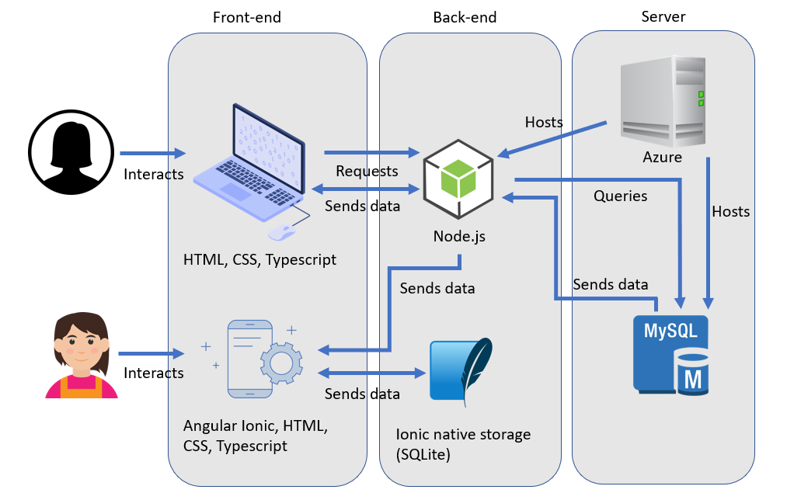
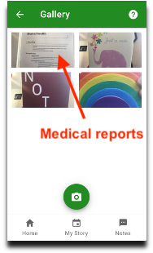
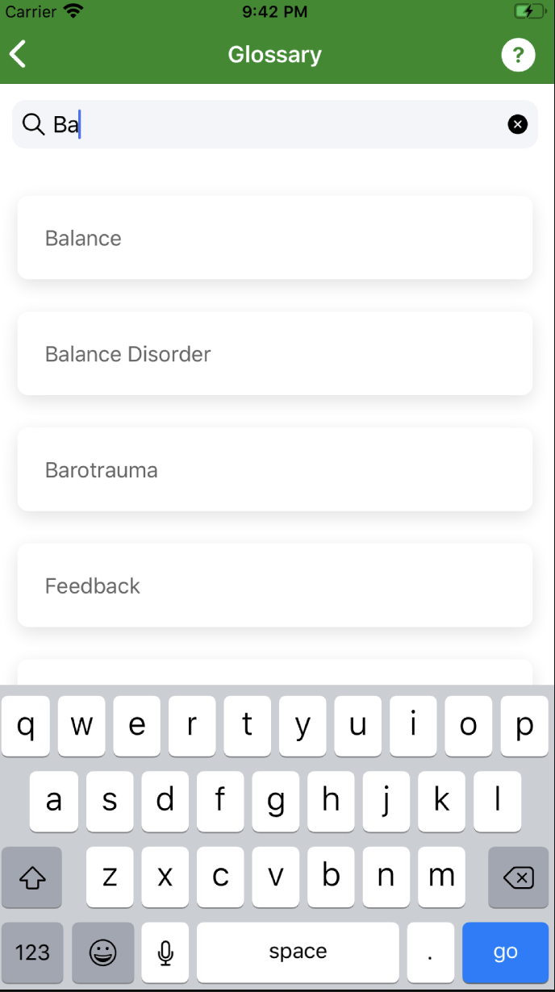
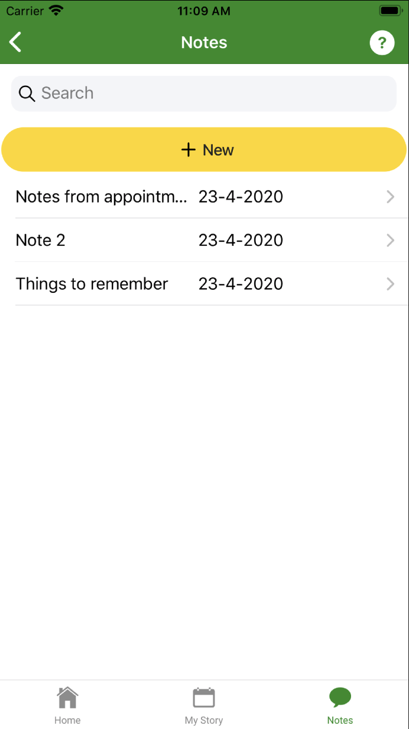
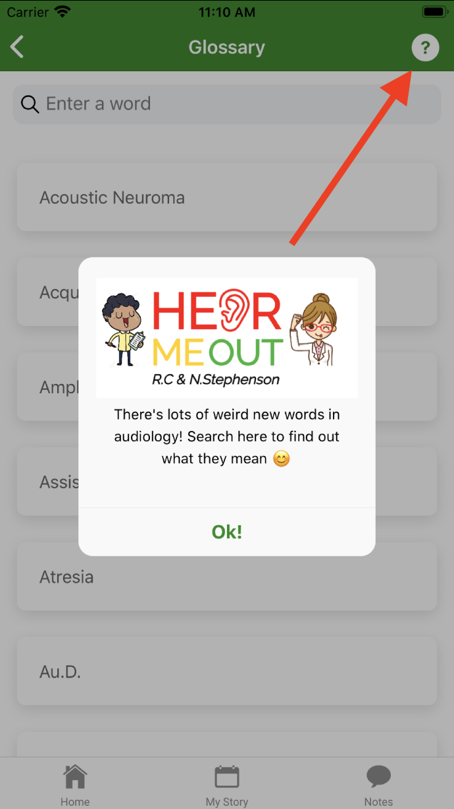
Abstract
Mobile App for Patients
Website CMS for Clinicians
Build a mobile app to help child audiology patients transition into the adult healthcare system. To include a website content management system (CMS) where articles, videos and photos can be uploaded to the mobile app by clinicians.
Home
Log appointments
Find services
Read articles
Technological Solution
Article upload
Photo upload
Glossary
Write Notes
Help buttons
By Team 19
Max Bosch, Jason James, Lucy Rothwell

